Slide 1
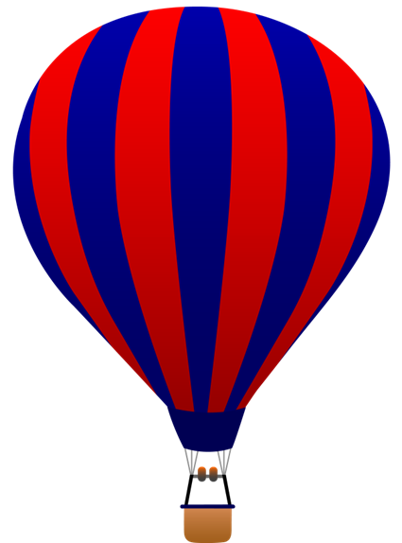
Hot Air Balloon Physics Open-bottom Balloon
LabRat Scientific
© 2018

Slide 2
Some basic ideas to keep in mind as we assess the physics of hot air balloon flight…

Slide 3
The Atmosphere
The atmosphere is composed of gas molecules. These molecules have mass, and they are acted upon by gravity.
The more molecules stacked above you, the higher the pressure you experience.
This is somewhat analogous to a stack of bricks. When you stack them up one on top of the other on a scale, the weight displayed on the scale increases. (Why isn’t this a perfect analogy?)
5 molecules above my head – lower pressure…
12 molecules above my head – lower pressure…

Slide 4
A Force Generated by Atmospheric Pressure
“Pressure” creates a “Force” when it acts on a surface. The “Area” over which the pressure acts dictates the magnitude of the force that will be applied.
Force = Pressure x Area
Lbs
Lbs = ----------- x Ft²
Ft²

Slide 5
Gas Behavior
Applying heat to a gas will excite the molecules.
As heat is applied, the molecules gain energy, and thus move faster.
The higher velocity of the molecules results in them having more kinetic energy (KE = ½ mV²) and more momentum (M = mV).
When molecules collide with each other or something else, momentum is transferred.

Slide 6
Useful Reference Data
Air Density = 1.226 kg/m³
Accel Due to Gravity = 9.8 m/sec²

Slide 7
Useful Equations
Air Pressure = Air Density * Gravity Accel * Height
Force_{Pressure} = Air Pressure * Area
Area_{Circle} = Pi * Radius²
Kinetic Energy = ½ * Mass * Velocity²
Momentum = Mass * Velocity

Slide 8
Open-Bottom Balloon Configuration
Hot air balloon can have an open bottom, or be closed off.
This lesson focuses on the open-bottom balloon.
In the open-bottom balloon, the pressure at the bottom of the balloon is the same as the atmospheric pressure at that level.
Open to the atmosphere at bottom

Slide 9
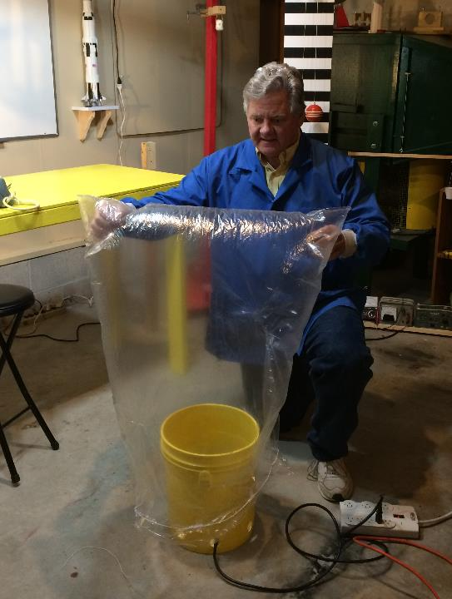
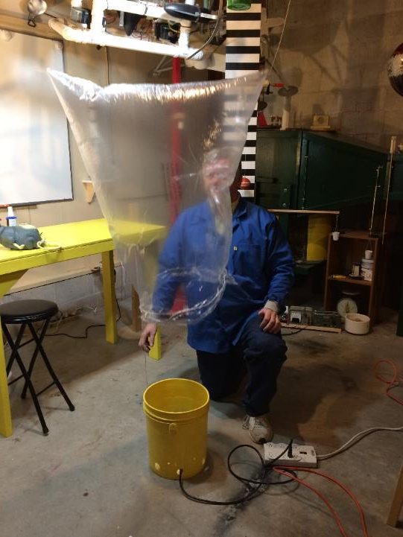
Open Bottom Hot Air Balloon
Dry cleaner bags make excellent demo balloons, but the complex geometry requires numerous approximations to be made, which affects the reliability of the calculations.

Slide 10
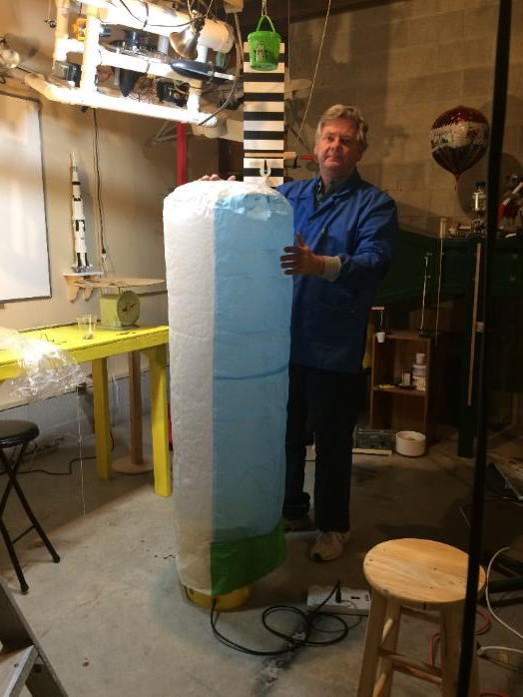
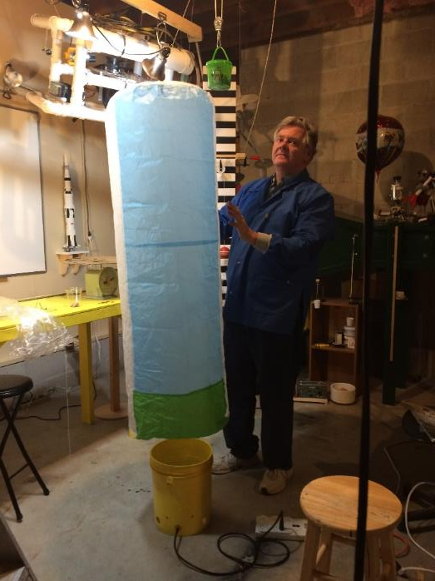
Open Bottom Hot Air Balloon
A flat-top, cylindrical balloon can be constructed from tissue paper to reduce approximations and make the calculations more a accurate.

Slide 11
What is creating the “Pressure”
If the gas inside the balloon is at the same temperature as the gas on the outside, all the molecules will have the same Kinetic Energy and Momentum.
As such, any outward momentum transfer is counteracted by an equal and opposite inward momentum transfer.
This means there is no net pressure acting on the balloon.

Slide 12
Heating the Gas in the Balloon
When the gas molecules in the balloon are heated, they become more energetic. In other words, they pick up Kinetic Energy. This also means the gas molecules have more Momentum.
When the molecules collide with the balloon wall, momentum is transferred. It is this momentum transfer that creates the pressure on the balloon material.

Slide 13
Vertical Momentum Transfer - Lateral
Any momentum transferred to the left side of the balloon is off-set by momentum being transferred to the right side.
This creates a pressure, pushing outward on the sides of the balloon.

Slide 14
Vertical Momentum Transfer - Upward
Momentum transferred to the top of the balloon creates an upward pressure.

Slide 15
Vertical Momentum Transfer - Downward
Any momentum that eventually gets transferred in the downward direction does not get transferred to the balloon because there is no bottom surface for the molecules to interact with.

Slide 16
Converting “Pressure” to “Force”
Force
A pressure acting against a surface will create a force.
And, of course, we need to know the forces involved before we can assess the resultant “motion” of the balloon.
Surface Area
Pressure

Slide 17
Calculating Pressure Force
Force_{Pressure} = Pressure * Area
Newtons
Force = -------------- * m²
m²
Force = Newtons

Slide 18
Directions of the Pressure Force
The internal pressure of the balloon acts on the top of the balloon, and on the sides.
However, for the open-bottom balloon there is no bottom surface for the gas molecules to transfer momentum to…
As a result, there is no downward force acting on the balloon material.

Slide 19
Pressure Forces
Now that we know how the pressure is created, we can drop the molecules from our diagram.

Slide 20
Pressure Forces
This makes for a cleaner diagram which doesn’t clutter our minds quite so much.

Slide 21
Lateral (Side-to-Side) Pressure Forces
The force acting on the left side of the balloon (actually all around the circumference of the balloon) is equal and opposite to the force acting on the right side of the balloon.
Newton says that since the forces are equal and opposite, there will be no net lateral force, and thus no resultant motion (or change in motion).
This means we can ignore the left and right side of the balloon in this thought experiment.

Slide 22
Open Bottom Hot Air Balloon
In the open bottom hot air balloon, the only surface that can interact with the internal and external pressure in the vertical direction is the top of the balloon.

Slide 23
Open Bottom Hot Air Balloon
Oops, one more look at the gas molecules…
In the open bottom hot air balloon, we don’t need to worry about the weight of the air inside the balloon because there is no bottom surface for it to react against.

Slide 24
Other Forces Acting on the Balloon
There is the weight of the balloon acting downwards. This force is composed of the balloon material and anything the balloon is carrying.

Slide 25
Other Forces Acting on the Balloon
There is also a downward pressure force acting on the top of the balloon.
Depending on how we analyze the balloon forces, dictates whether we need to account for this force. If we look only at “differential” force on the top of the balloon, we don’t really need to worry about the atmosphere…

Slide 26
We can depict all of these forces onto a simple diagram known as a Free Body Diagram (FBD).

Slide 27
Free Body Diagram
Downward Pressure Force due to atmospheric pressure pushing down on the balloon material
Upward Pressure Force due to internal pressure pushing up on the balloon material
Downward Force due to the weight of the balloon material and any payload it is carrying

Slide 28
Proving an Upward Force Exists
An experiment with an inflated hot air balloon can demonstrate that there is indeed an internal pressure being generated inside the balloon – even with the bottom of the balloon open to the atmosphere.
First, we should examine an example where there is no upward pressure force being exerted…

Slide 29
Experimental Set-up
Atmospheric Pressure
Tissue Paper
Pennies
Atmospheric Pressure
Cardboard Ring
Support Block (4 ea)
We will place pennies on the tissue paper to see if they can be supported.

Slide 30
Experimental Set-up
The ambient air pressure on the top surface of the tissue paper is exactly opposed by the ambient air pressure on the bottom surface of the tissue paper.
Since the forces (pressure * area) are balanced, there is no net force. There is neither a downward pressure force nor an upward pressure force.
Of course, there is a gravity force (weight of the paper), so the tissue will sag a little…

Slide 31
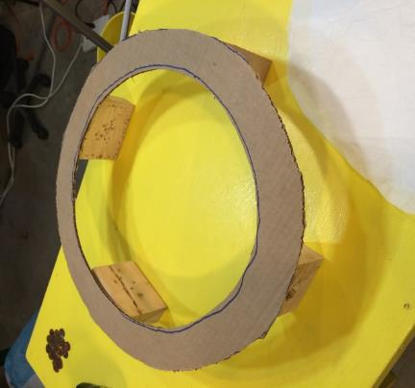
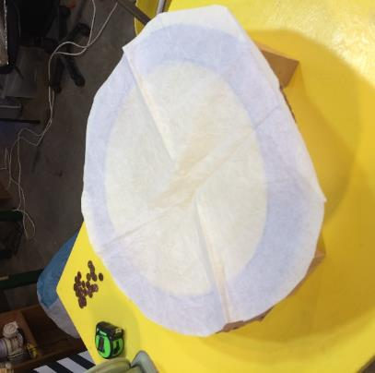
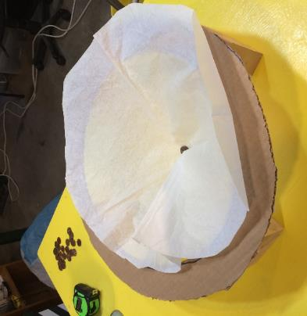
Proving an Upward Force Exists
A cardboard ring is used to support a sample of tissue paper – the same material used to make the balloon.
The tissue paper is placed on top of the ring. The paper is just stiff enough to support itself.
Pennies are added to see what happens - the tissue paper collapsed when one single penny was added.

Slide 32
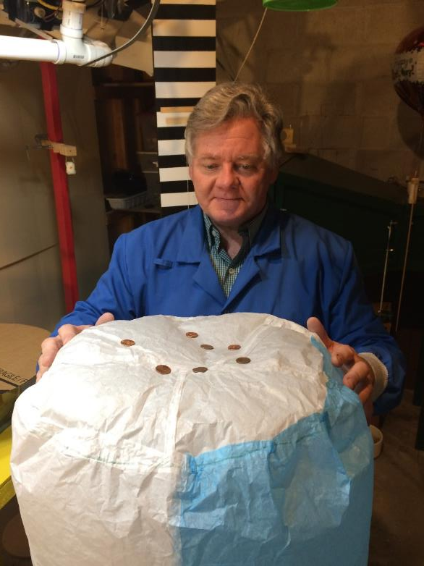
Proving an Upward Force Exists
Here you can see that the pressurized balloon is capable of supporting several pennies.
Since the tissue paper is barely stiff enough to support itself, the only way the top of the balloon doesn’t collapse is because of an upward force being applied.

Slide 33
Temperature Gradient in the Balloon
If hot air rises, then it stands to reason that the air should be hotter at the top of the balloon, and get cooler towards the bottom.
Hot Air
Warm Air
Cooler Ambient Air

Slide 34
Pressure Gradient in the Balloon
If pressure is related to gas temperature, then it also stands to reason that there should also be a pressure gradient in the balloon, with higher pressure towards the top.
Higher Pressure
Lower Pressure
Ambient Air Pressure

Slide 35
Verifying the Existence of a Pressure Gradient
As we will see in later slides, the “high” pressure inside the balloon is not really that “high”. Actually its just a tad bit “higher” than the pressure outside the balloon.
As such, it will be difficult to measure the pressure. We can conduct a qualitative experiment to try to assess if there is actually a pressure gradient in the balloon.
This test involves “squeezing” the balloon at various locations to see if it possible for “feel” a difference in the outward force acting on the balloon material.

Slide 36
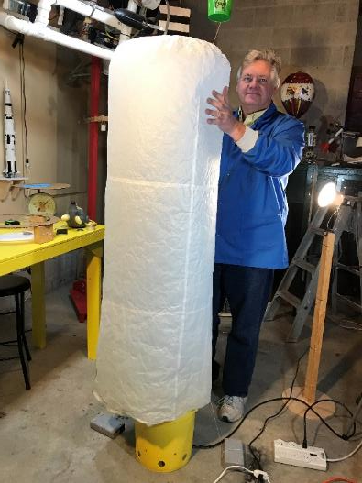
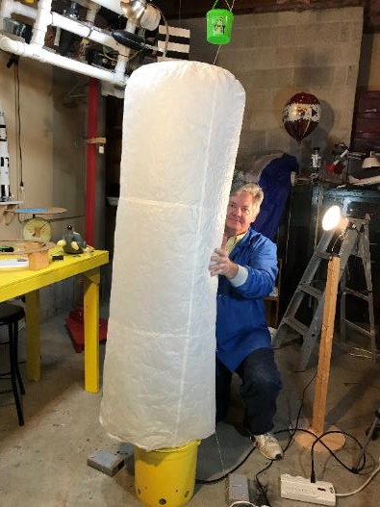
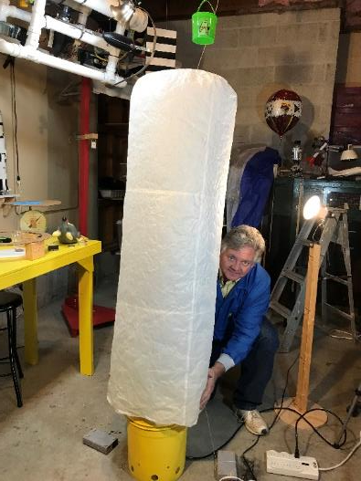
The balloon material “feels” tighter at the top of the balloon.
The balloon material doesn’t feel quite as tight at the center of the balloon.
There is hardly any internal pressure at the bottom. The material hardly rebounds after being pushed inward.

Slide 37
This qualitative experiment seems to support the idea that there is a vertical pressure gradient in the balloon.
Higher Pressure
Lower Pressure
Ambient Air Pressure

Slide 38
Calculating the approximate pressure inside the hot air balloon
(at least near the top).
The first step is to create a neutrally buoyant system.
A neutrally buoyant balloon neither rises nor sinks (vertical acceleration is zero: F=ma…). In this state, the upward force is equal and opposite to the downward force.

Slide 39
Adding pennies to the top (or bottom) of the balloon allows the “free lift” of the balloon to be determined. If the pennies are added to the balloon just to the point where the balloon barely rises (essentially “neutrally” buoyant), we know the upward force is about equal to the downward force.
When we have this condition, we can use some basic physics to approximate the pressure of the hot air inside the balloon. Actually it’s the differential pressure between the air inside the balloon and the ambient pressure outside the balloon at the top of the balloon.

Slide 40
Initially, the balloon was just barely able to lift itself and 7 pennies.

Slide 41
Gravity Force of tissue paper and pennies
In the neutrally buoyant state, the Pressure Force is equal and opposite the Gravity Force.
Thus, if we know downward force, we know the upward force acting on the bottom surface of the balloon top.
We can then back out the pressure needed to provide the required force.
Pressure Force

Slide 42
Balloon Geometry
To calculate the pressure, one of the things we need to know is the area of the top of the balloon.
Radius of Top = 0.23 m
Area of Balloon Top = Pi * r²
= 3.1416 * (0.23 m)²
= 0.17 m²
h = 1.4 m

Slide 43
From the Free Lift Experiment:
The balloon was neutrally buoyant with 7 pennies, the cup plate, and the balloon material. The mass of these items was measured to be 0.066 kg. We need to calculate the downward force (i.e. weight).
Area of Top = 0.17 m²
h = 1.4 h
Weight = Mass * Accel Due to Gravity
= 0.066 kg * 9.8 m/sec²
= 0.65 N
This is the upward force needed to balance the weight of the balloon system

Slide 44
Calculate Required Pressure:
A pressure force is required to balance out the downward force in the neutrally buoyant case.
0.65 N
Force = Pressure * Area
Force
Pressure = ----------
Area
Area of Top = 0.17 m²
0.65 N
Pressure = ---------------- = 3.8 N/m²
0.17 m²

Slide 45
Pressure = 3.8 N/m²
This is actually a very small pressure differential across the top of the balloon.
If you are more accustom to English units, this is equal to 0.0006 PSI above the outside ambient pressure.
You can see why actually measuring this pressure would be very difficult!
This tells us that it doesn’t take a huge pressure differential to get a hot air balloon to work…

Slide 46
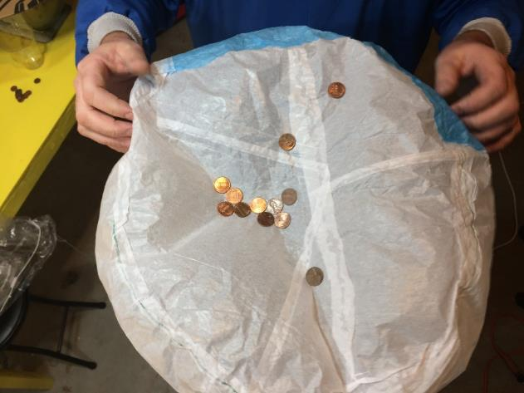
We have to be careful to control this experiment. If the gas is heated for a longer time, the pressure at the top of the balloon will increase. If the pressure increases, more pennies can be supported.
After allowing the heat gun to run for several minutes during the experiment, a total of 12 pennies could be supported.

Slide 47
Questions?

